Slide 1


WELCOME! TO CAMPUS CHAM

Slide 2
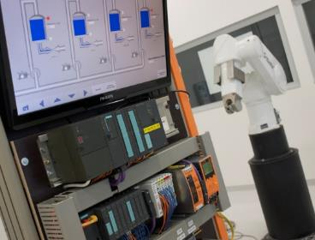
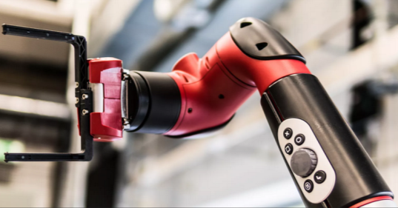
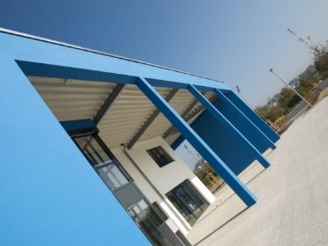
CAMPUS CHAM
EEG-Based BCI for Assistive Robotic Arm Control
Dikonda Prajwal
Shetty Nishant
Dhavan Papiha
Cham,

Slide 3

EEG-Based BCI for Assistive Robotic Arm Control
A complete Brain–Computer Interface pipeline that decodes motor imagery signals from EEG and translates them into real-time robotic commands — validated in Gazebo simulation via ROS2.
METHODOLOGY OVERVIEW

Slide 4

System Architecture
The pipeline flows from raw brain signal to physical robotic action across seven tightly integrated stages.
EEG Acquisition
Grasp / Release Action
Feature Extraction
Each stage is modular and independently replaceable, enabling safe simulation-first validation before deployment on physical hardware.

Slide 5
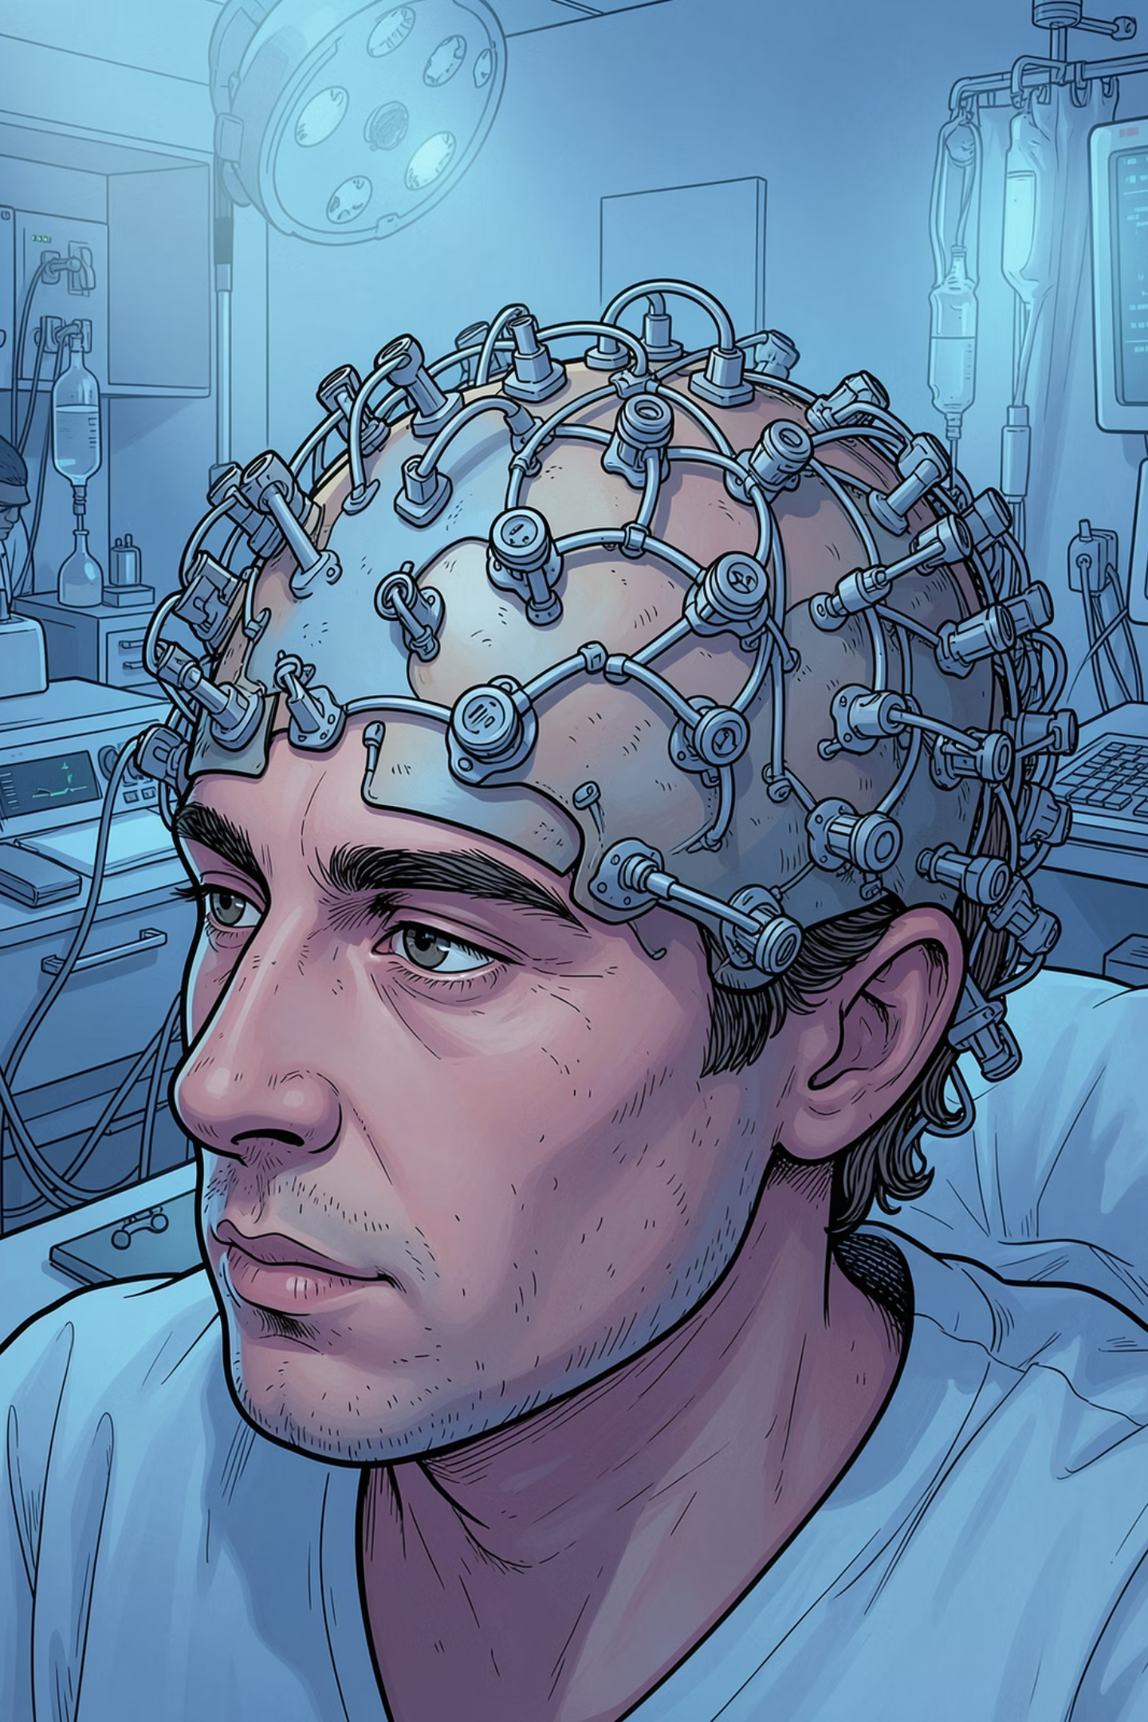
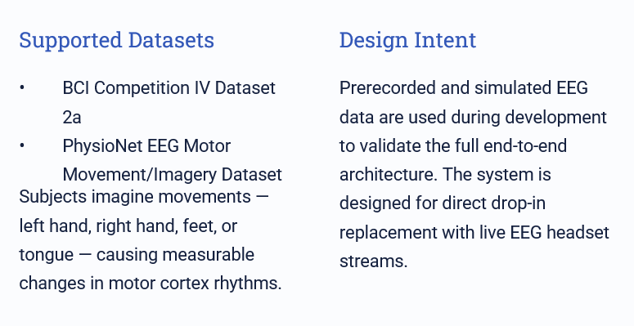
Stage 1 — EEG Data Acquisition

Slide 6
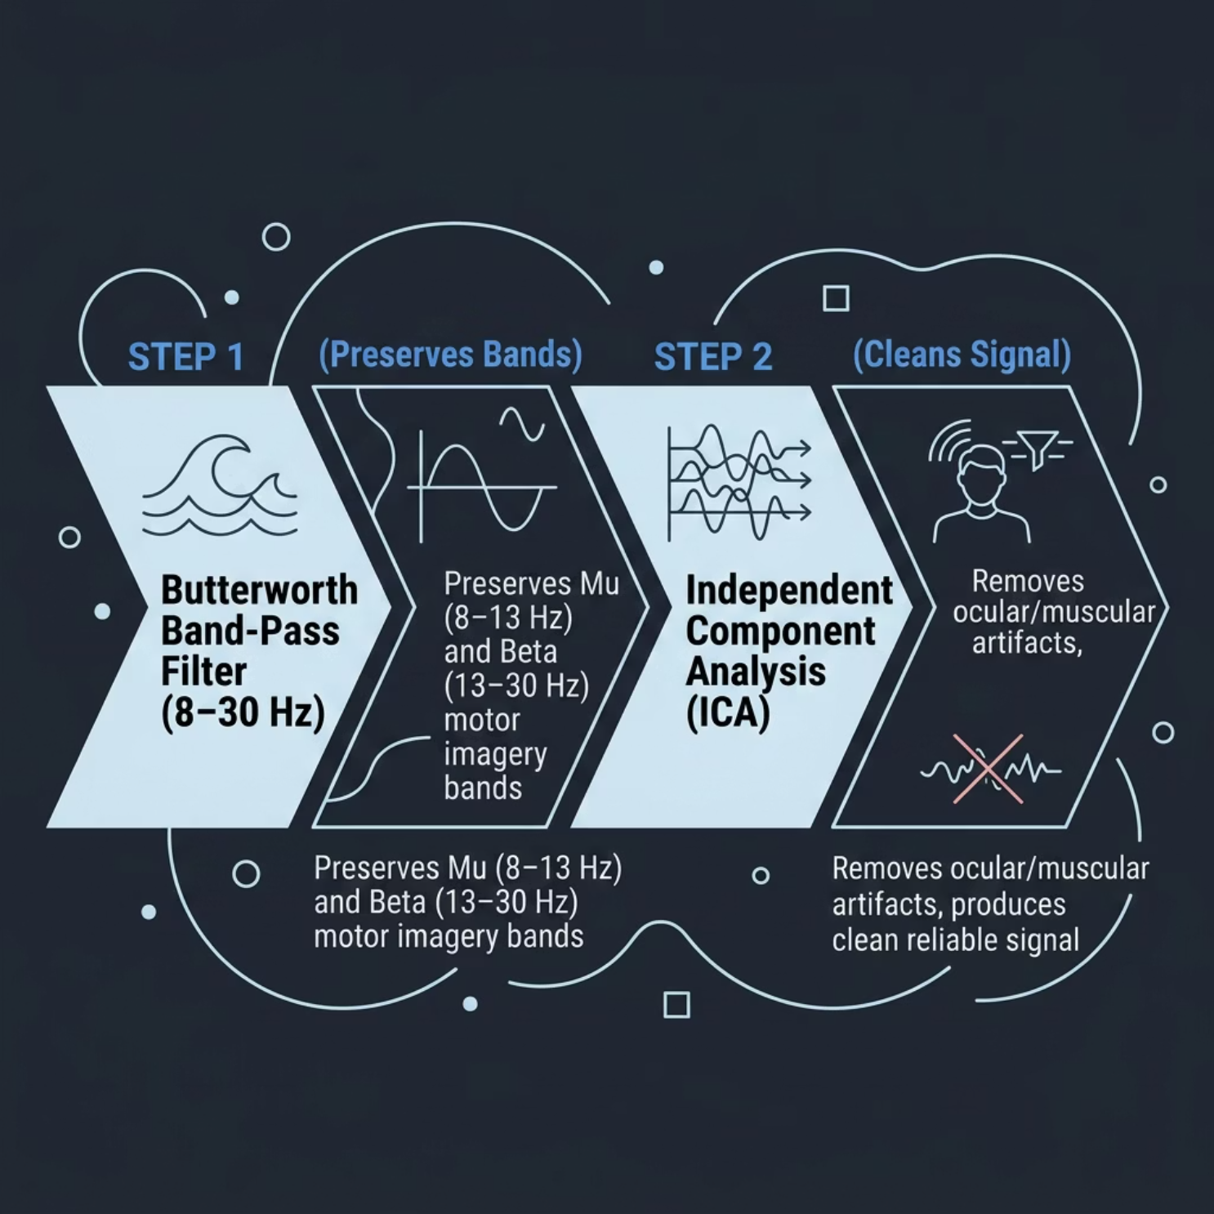

Stage 2 — Signal Preprocessing
Raw EEG is corrupted by eye blinks, muscle movement, electrical interference, and electrode motion. Two sequential steps restore signal integrity
Why 8–30 Hz?
Motor imagery information resides in two key bands:
Mu (8–13 Hz) — motor cortex idling activity
Beta (13–30 Hz) — movement imagination signatures
ICA is particularly effective at isolating eye-blink artefacts, which are among the most disruptive noise sources in EEG recordings.

Slide 7
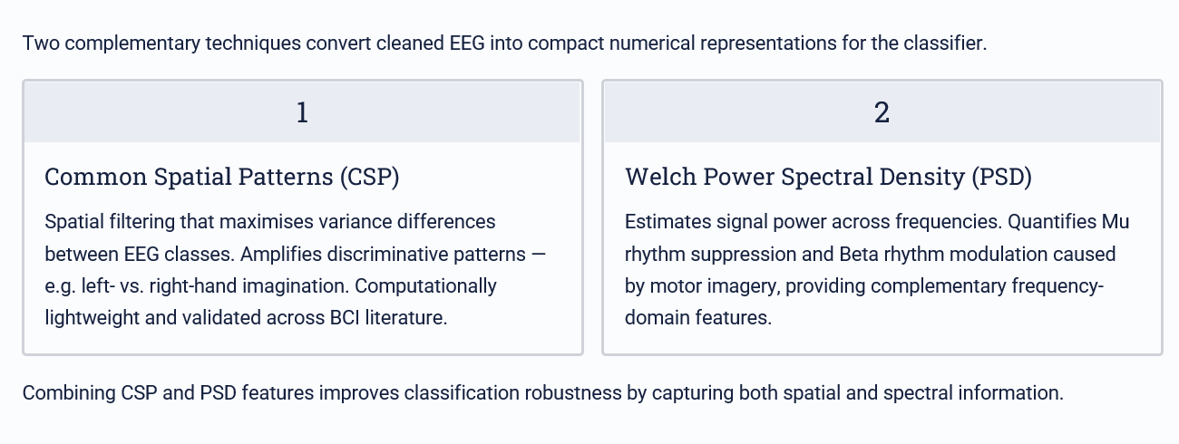
Stage 3 — Feature Extraction

Slide 8
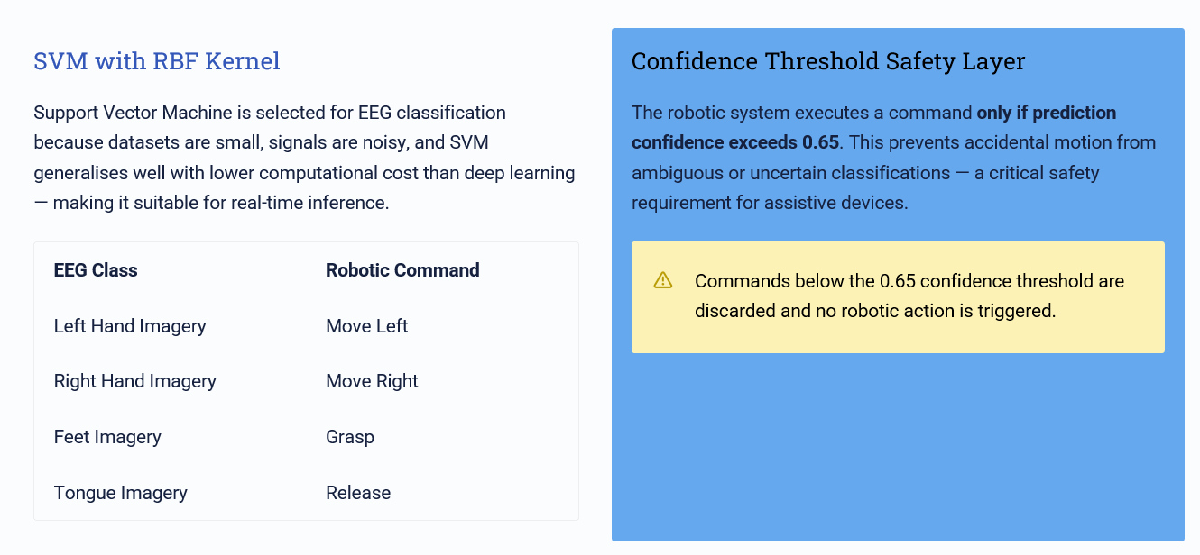
Stage 4 — Classification & Safety

Slide 9
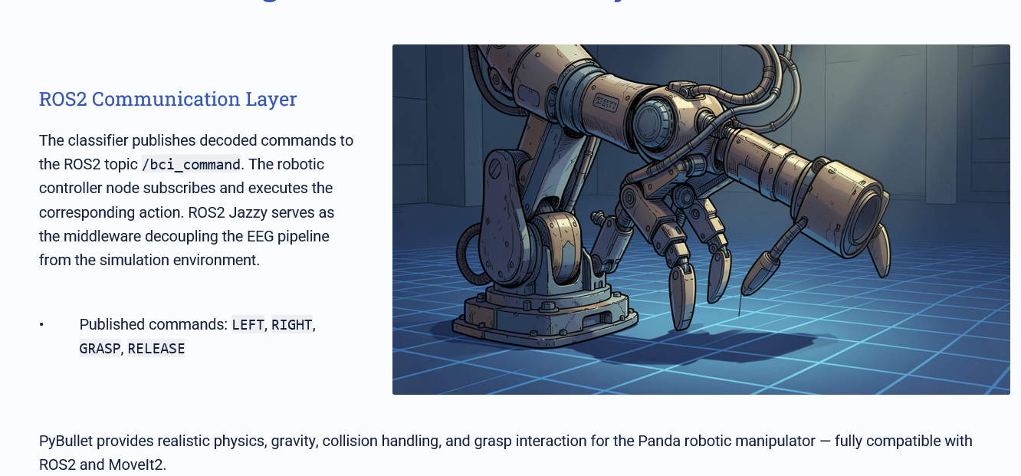
Stage 5 & 6 — ROS2 + Gazebo Simulation
It

Slide 10
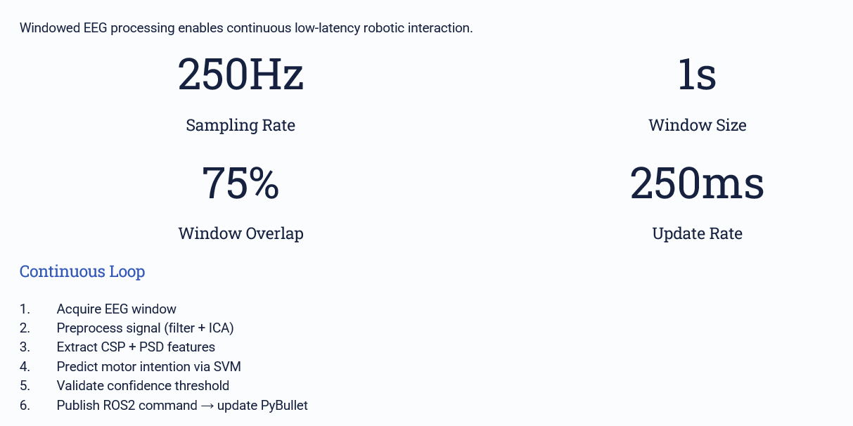

Real-Time Processing Pipeline
Gazebo

Slide 11
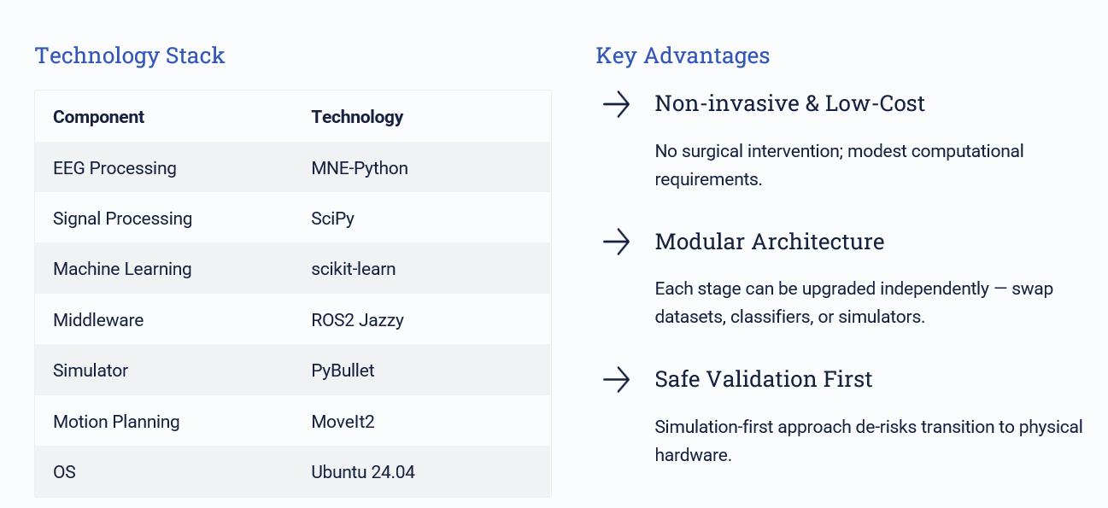

Software Stack & Advantages
Gazebo

Slide 12
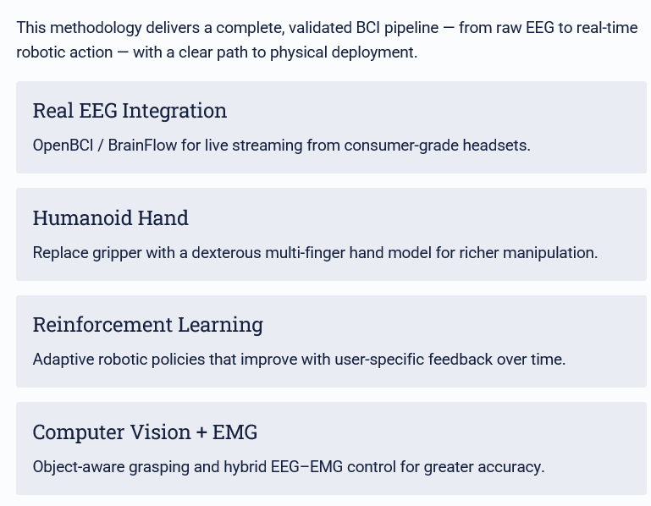
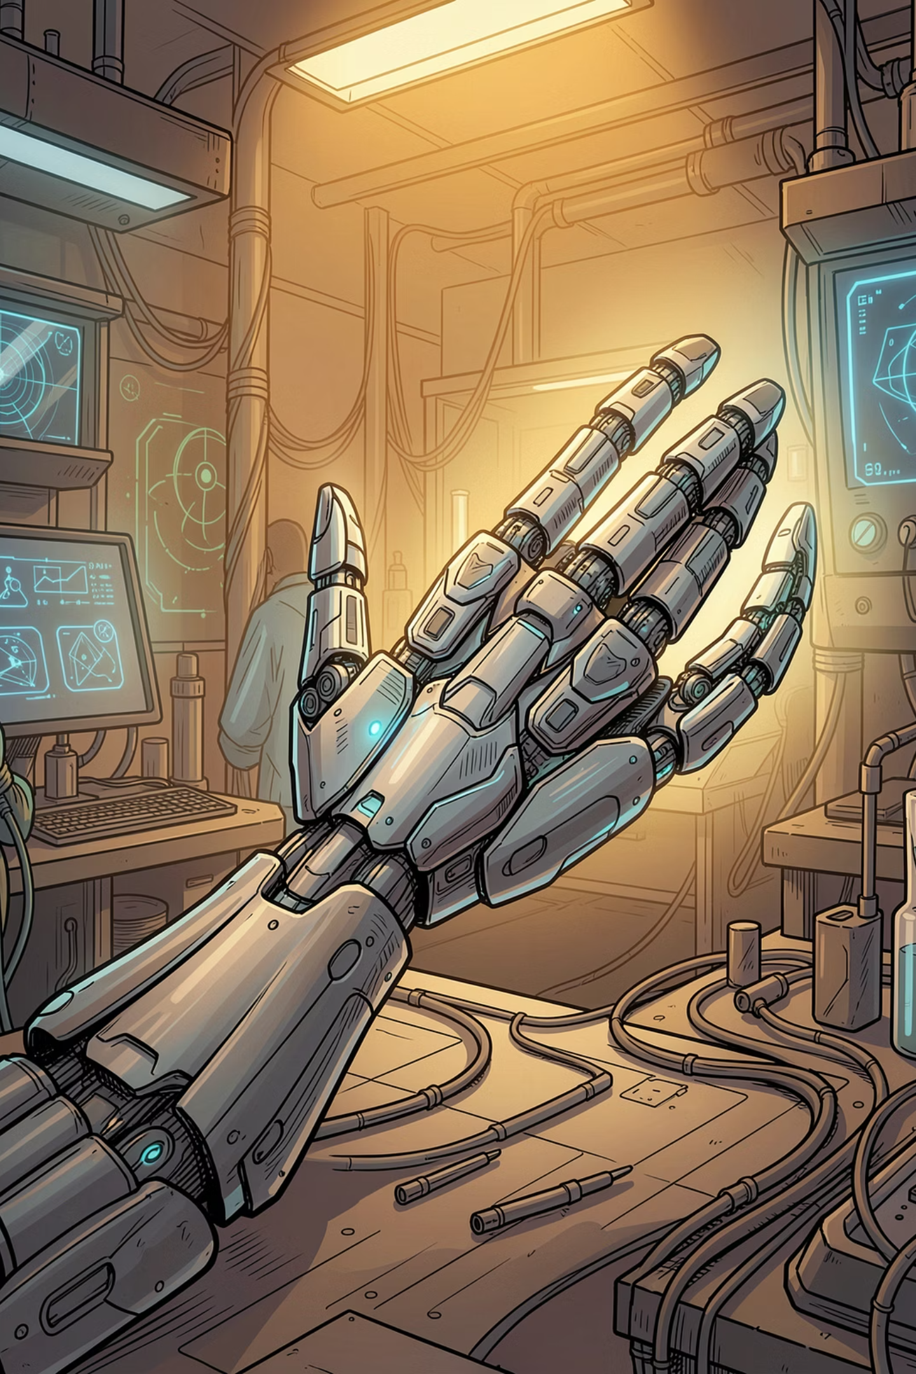
Conclusion & Future Scope

